Slide 1
UI Change – Input – V1
May 28, 2017 Robin Wei

Slide 2
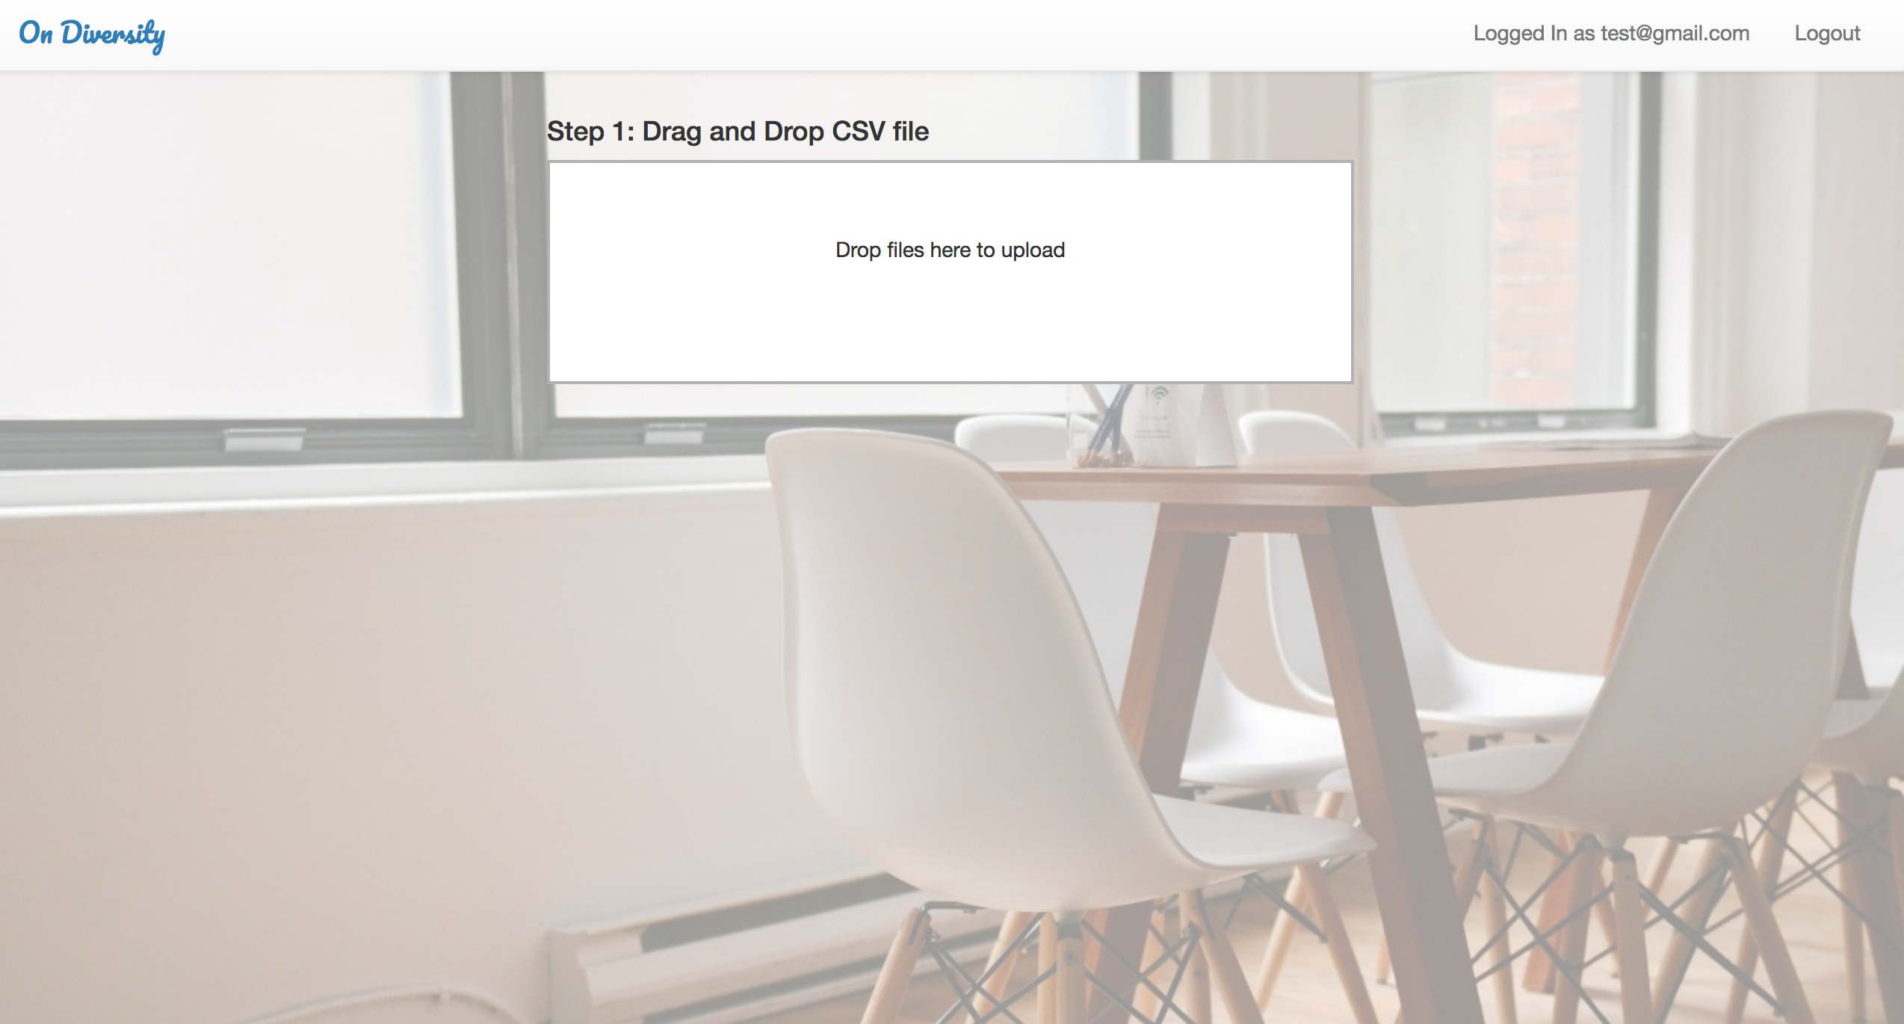
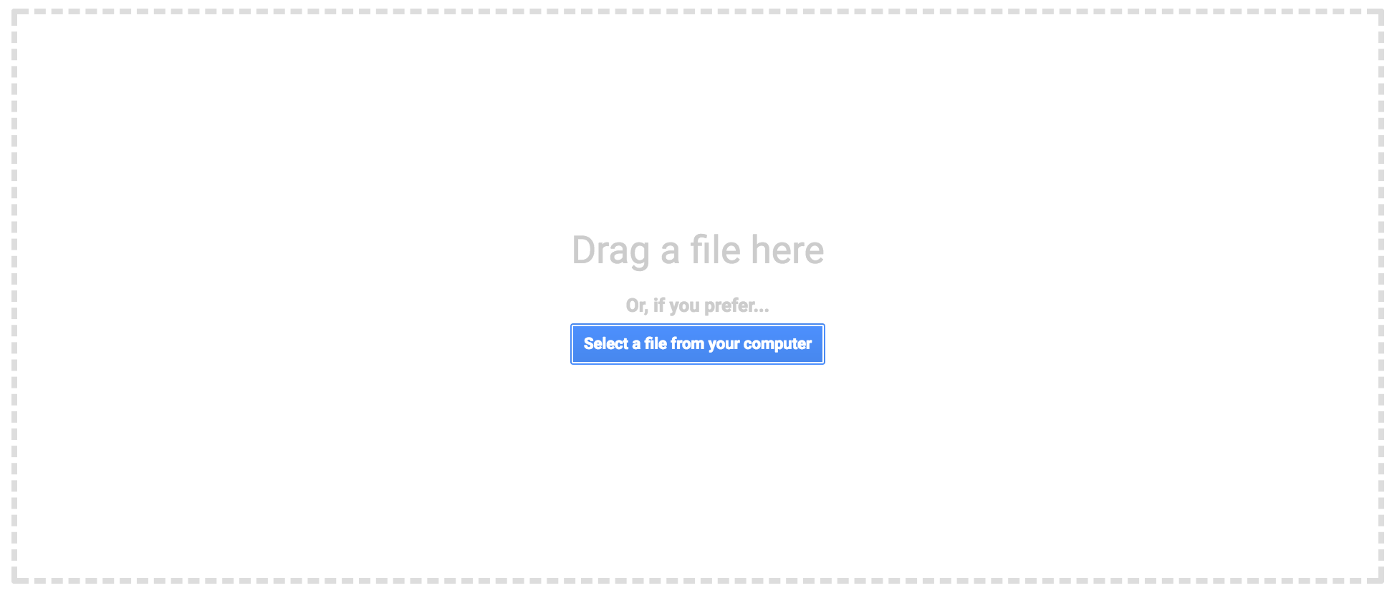
“Step 1: Upload a CSV file”
Add a button to indicate alternative file-selecting method. (example from Google)

Slide 3
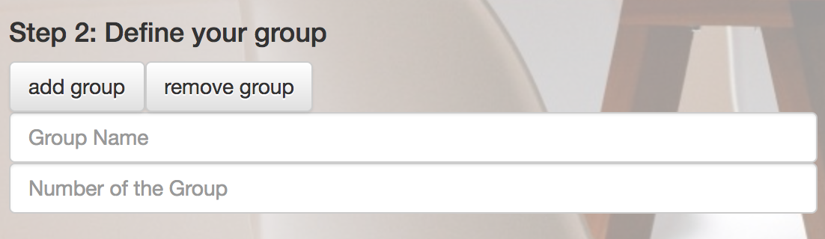
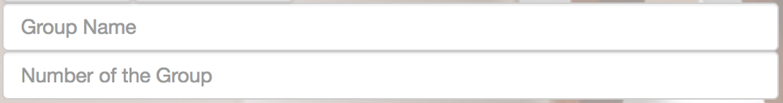

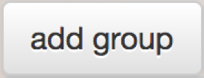
Re-arrange the text box and button as followed
Give example with grey text
Step 2. Define your groups
Group Name
eg. Section
Number of Groups
eg. 4
Button should grey out if text box is empty

Slide 4
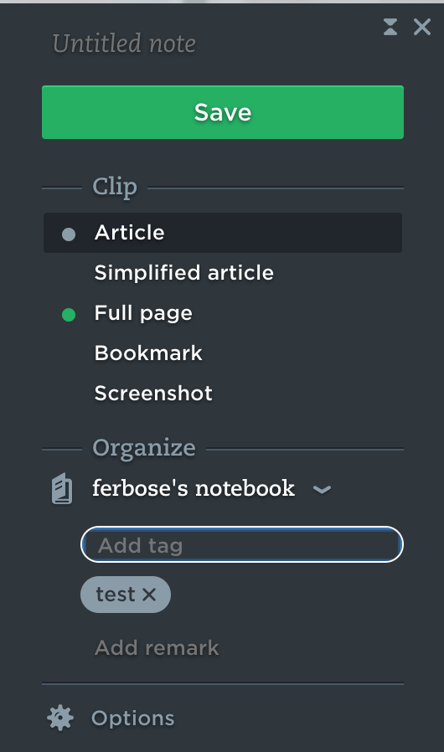
After pressing ”Add Group”…
Step 2. Define your groups
Group Name
eg. Section
Number of Groups
eg. 4
Add group (Capitalize every first letter of sentence/action)
Group list
Section divide into 4 groups
Add subgroup
Edit
Ex1. Are you sure to delete the group “Section”? (yes or no button)
Smaller size text to describe the group
Remove button to delete created group Give confirm dialogue before deleting
Ex2. With subgroup created: Are you sure to delete the group “Section”? This will also delete the subgroup “Study group” under ”Section” (yes or no button)
Inspired by label object in Evernote:

Slide 5
Adding subgroup…
Step 2. Define your groups
Group Name
eg. Section
Number of Groups
eg. 4
Group list
Section divide into 4 groups
Add subgroup
Edit
Both buttons grey out when adding subgroup
Add subgroup
Subgroup name
eg. Study group
Number of subgroups
eg. 15
Both buttons should grey out if text box is empty
Cancel
Add

Slide 6
Editing group…
Step 2. Define your groups
Group Name
eg. Section
Number of Groups
eg. 4
Group list
Section divide into 4 groups
Add subgroup
Edit
Both buttons grey out when editing group
Edit group
Group name
eg. Study group
Number of groups
eg. 15
Both buttons should grey out if text box is empty
Cancel
Add

Slide 7
After adding subgroup…
Step 2. Define your groups
Group Name
eg. Section
Number of Groups
eg. 4
Group list
Section 1 divide into 4 groups
Add subgroup
Edit
Indent subgroup under group object
Study group divide into 15 subgroups under each Section1
Edit
Decorating line between group objects
Section 2 divide into 4 groups

